Slide 1

SML: A New Interface Into Soar
Douglas Pearson
+ Bob, Jon, Karen, Trevor, Devvan, John
douglas.pearson@threepenny.net

Slide 2
Short-Term Problem
New debugger
  Avoid string parsing
  Use Java for faster tool development
  Dynamic attachment to existing processes
  High performance
gSKI integration
  Removal of existing command line
Redux choice to use JESS for rule matcher

Slide 3
Long-Term Problem
Interfacing to Soar has always been hard
  Initially limited to implementation language (LISP/C)
  Extended to Tcl but lead to dependencies on Tcl
  SGIO supported embedded kernels but only for I/O
  gSKI added clean interface to kernel but multiple languages, debugging and remote I/O unimplemented.

Slide 4
Key Properties of our Solution
Supports multiple languages (Java, C++, Tcl currently) while removing Tcl dependency
Supports uniform interface for I/O (environments) and commands (debuggers)
Supports embedding kernel within debugger or environment with remote connections between them
Supports multiple clients (environments, tools, debuggers etc.) connecting to a single kernel
Supports dynamic connection and disconnection of tools (esp. debuggers) from a running kernel
Provides a uniform, high-level, data-driven model for the entire Soar interface while achieving high performance
Moves command line support out of the kernel while providing universal access to it from any client
Includes a new cleaned up command line interface
Lots of new capabilities yet in most cases the new interface is substantially faster than 8.5.2
No production level changes (except ‘tcl’ -> ‘exec’)

Slide 5
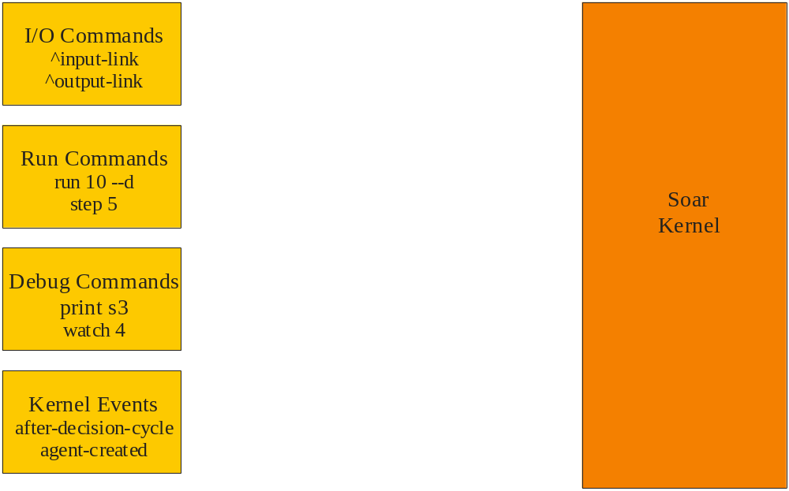
Connecting to Soar

Slide 6
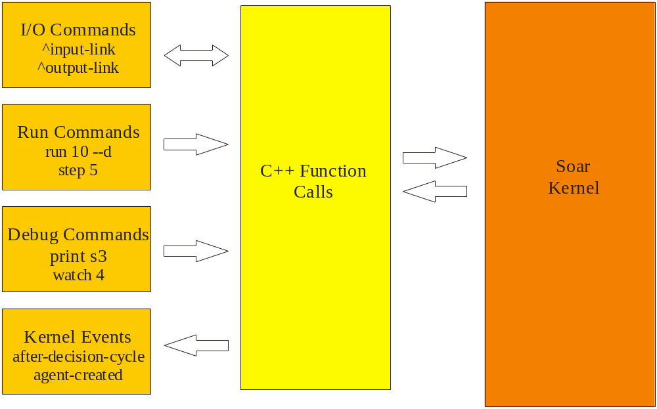
Connecting to Soar
Direct Link to Kernel
Soar 6/7
gSKI
Soar 8.4/8.5

Slide 7
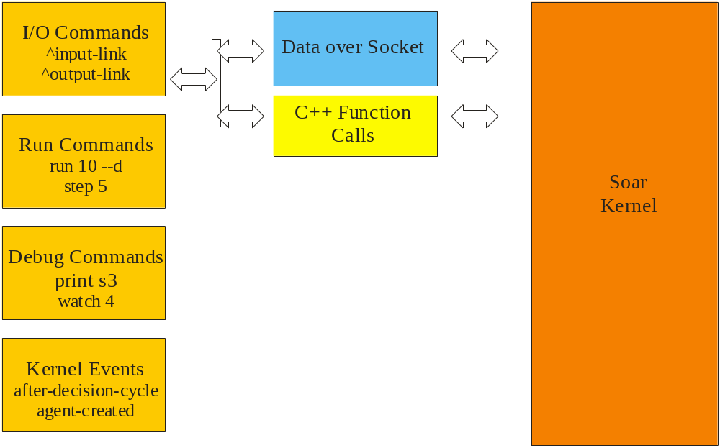
Connecting to Soar
SGIO Style
Code forks between
embedded and remote
Client (environment) unaware
Only I/O

Slide 8
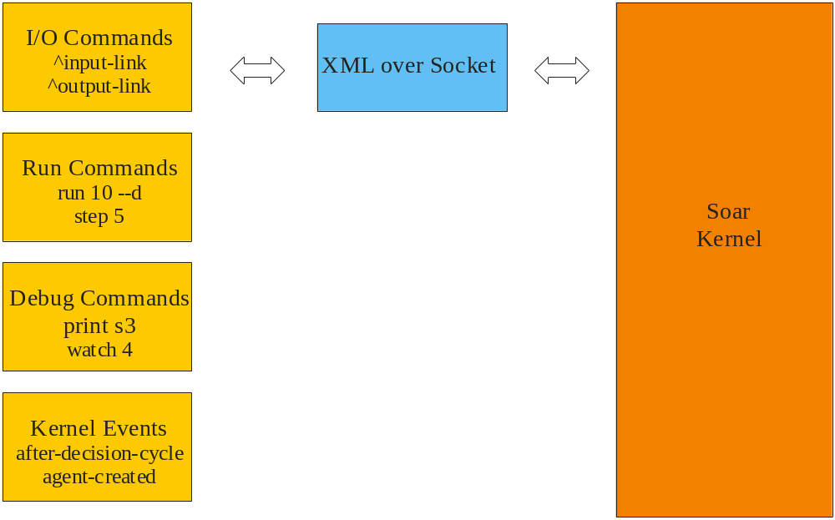
Connecting to Soar
ATE Style?
Primarily I/O but includes
higher level concepts?
Custom code per language?
Proprietary

Slide 9
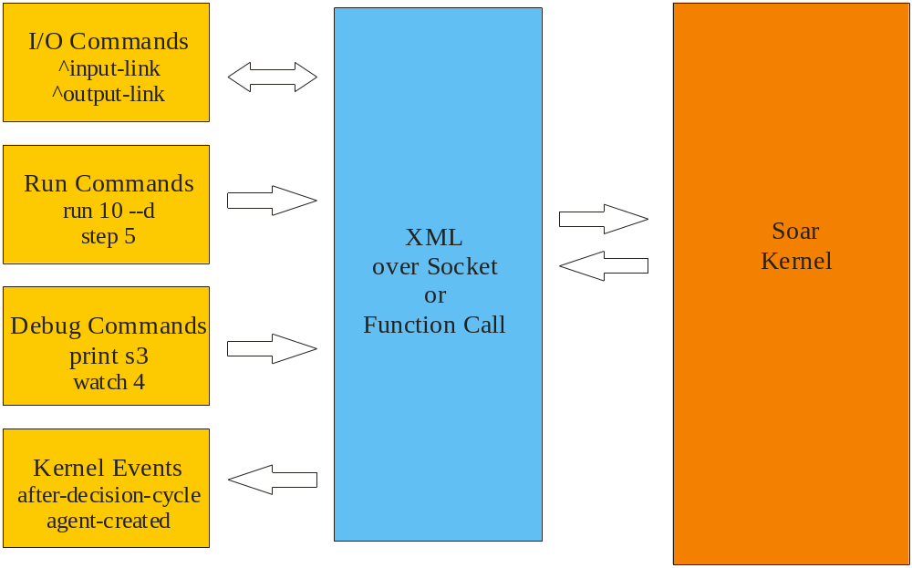
Connecting to Soar
SML Style – Soar Markup Language
Uniform for entire interface

Slide 10
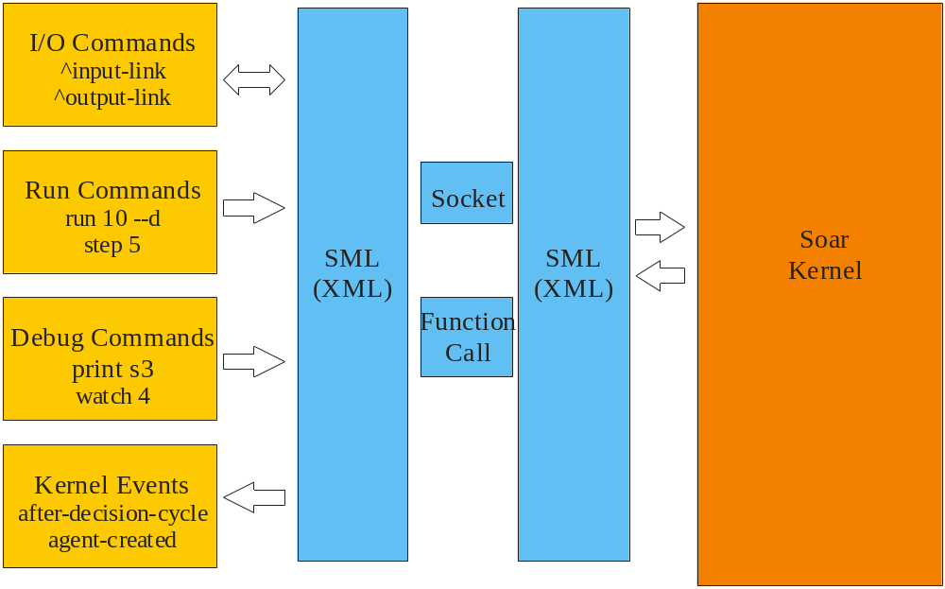
Connecting to Soar
SML Style – Soar Markup Language
Internally use socket or function call
Client, Kernel and (99%) SML code all unaware

Slide 11
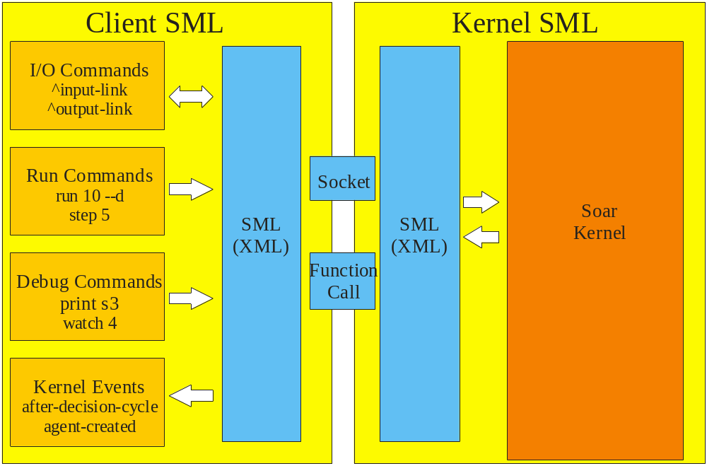
Connecting to Soar
SML Style – Soar Markup Language

Slide 12
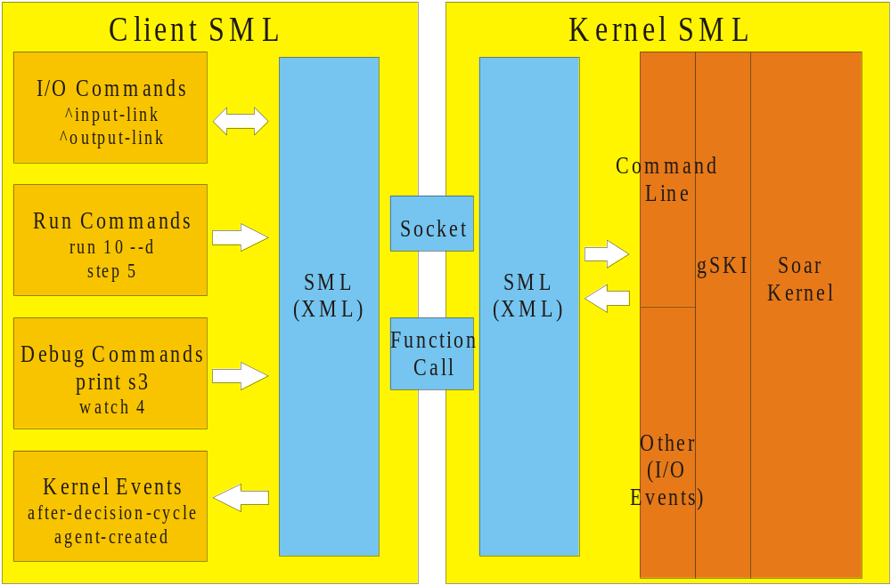
Connecting to Soar
SML Style – Soar Markup Language

Slide 13
Possibly useful ways to think about SML
An XML interface into the kernel
  A data-driven approach rather than function calls
A remote procedure call protocol for the kernel
  Although it’s not just for remote calls
A language independent way to access the kernel
SOAP/Web Service for the kernel
  Although again not limited to remote access

Slide 14
De-Coupling from the Kernel
Two central tenets for good software design
  High cohesion
    Each class does one thing not several things
  Loosely coupled
    Each class knows as little as possible about the classes they interact with
What is good for classes is good for modules

Slide 15
SML Makes Systems More Loosely Coupled to Soar
8.5/gSKI Interface size (# functions which break client if changed and not recompiled) ~= 1000
SML reduces this to 2 (+ about 20 for ElementXML)
Why does this matter?
Supports a larger community building clients – may not have source available
Allows a single client to support multiple different kernel versions because data-driven
By default builds to 2 libraries with no dependencies
So less coupled to Tcl or other stuff

Slide 16
SML Example Packets
“Print chunk-1”
<sml smlversion=”1.0” doctype=”call” soarVersion=”8.6.1” id=”657” >
<command name=”print”>
<arg param=”agent”>agent-1</arg>
<arg type=”string” param=”name”>chunk-1</arg>
</command>
</sml>
“Output (O1 ^turn T1) (T1 ^heading 045 ^speed 225)”
<sml smlversion=”1.0” doctype=”call” soarVersion=”8.6.1” id=”1763”>
  <command name=”output”>
  <arg param=”agent”>agent-1</arg>
  <wme action=”add” att=”turn” id=”O1” tag=”7” type=”id” value=”T1”></wme>
  <wme action=”add” att=”heading” id=”T1” tag=”6” type=”int” value=”045”></wme>
  <wme action=”add” att=”speed” id=”T1” tag=”12” type=”int” value=”225”></wme>
  </command>
</sml>

Slide 17
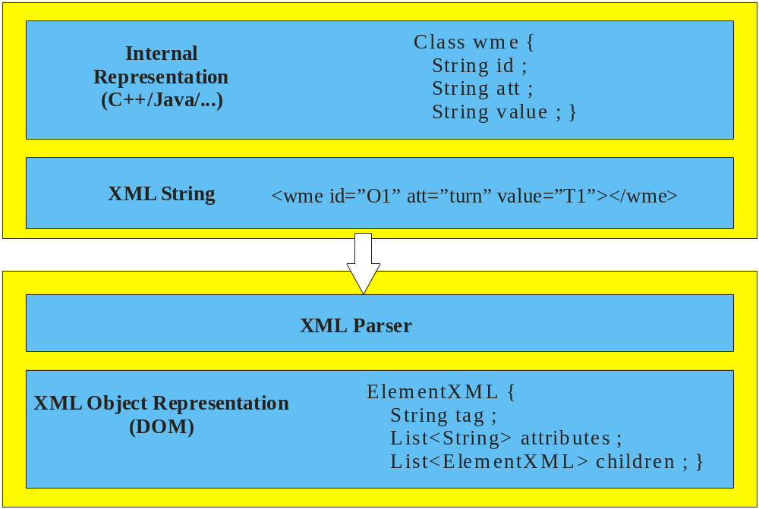
Maximizing XML performance
Standard Approach for passing XML
-- Always requires parsing step

Slide 18
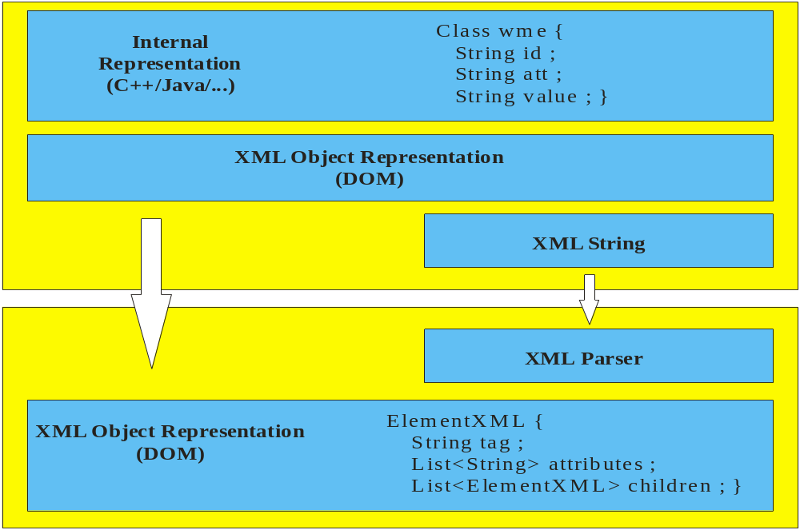
Maximizing XML performance
SML Approach – create DOM representation directly
- only convert to XML string if needed
Speed benefit ~50x if always use socket
Speed benefit ~10x if pass string directly

Slide 19
Building an SML Client
Option A: Just send XML strings to socket
  Format: 4 byte length + XML string
  Not recommended, lose embedded speed and need details on XML packets but an option
Option B: Use client SML functions we provide in
  C++
  Java
  Tcl
  more…

Slide 20
Creating Kernel and Agents
Local Kernel
  Kernel* pKernel = CreateKernelInNewThread()
    Generally recommended
  Kernel* pKernel = CreateKernelInCurrentThread()
    Tcl only supports this form (so far)
    Call CheckForIncomingCommands() periodically
Remote Kernel
  Kernel* pKernel = CreateRemoteConnection(ipAddress, port)
    Pass null for ipAddress => same machine
Agents
  CreateAgent()
  DestroyAgent()
Shutdown
  delete pKernel object
  disconnects
  cleans up all memory

Slide 21
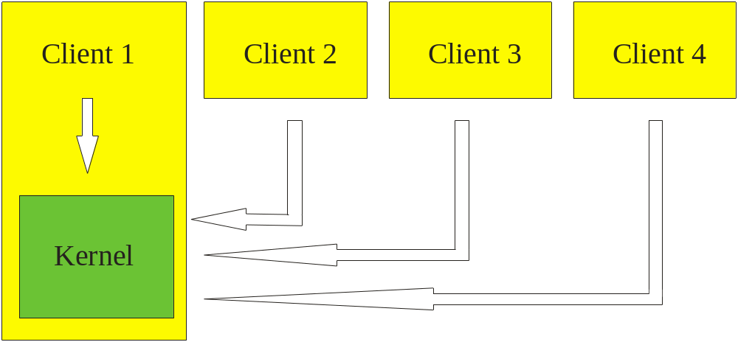
Local vs Remote Kernels
CreateKernel
InNewThread()
CreateRemote
Connection()
CreateRemote
Connection()
CreateRemote
Connection()

Slide 22
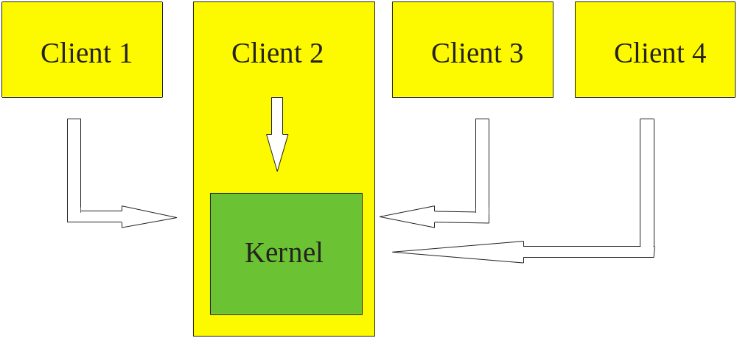
Local vs Remote Kernels
CreateRemote
Connection()
CreateKernel
InNewThread()
CreateRemote
Connection()
CreateRemote
Connection()
Change one line of code
Internally different execution paths
  XML objects + local functions vs XML strings + sockets
To the client, same interface and capabilities
No special access for debugger

Slide 23
Input
Add structures to input link representation
  Identifier* pInputLink = pAgent->GetInputLink()
  Identifier* pID = pAgent->CreateIdWME(pInputLink, "plane") ;
  StringElement* pWME1 = pAgent->CreateStringWME(pID, "type", "Boeing747") ;
  Result: (I1 ^input-link I2) (I2 ^plane P1) (P1 ^type Boeing747)
Send changes to kernel
  pAgent->Commit() ;
  Actual wmes added during next input phase
Update or remove in future cycles
  pAgent->Update(pWME1, “Cessa”) ;
NOTE: init-soar works and comes for free.
  Sends over current input state automatically so you can pick up reasoning

Slide 24
Output
Check for output commands (since last check)
  Based on “command” notion on output link
  E.g. (I1 ^output-link I3) (I3 ^move M1) (M1 ^speed 20)
  pAgent->GetNumberCommands() ;
  Identifier* pCommand = pAgent->GetCommand(i) ;
  string name = pCommand->GetCommandName() ;
  string speed = pCommand->GetParameter(“Speed”) ;
  pCommand->AddStatusComplete() ;
    Same as pAgent->CreateStringWME(pCommand, “status”, “complete”) ;
But not forced to use this model
  GetCommand() returns Identifier*. Can access substructure directly.
  GetOutputLink() and walk output link directly.
  GetOutputLinkChange() to walk list of WMEs changed
Call ClearOutputLinkChanges() after reading the output link
  Allows SML to only report changes to the output link.

Slide 25
Running Soar
Run
  Kernel->RunAllAgentsForever()
  Kernel->RunAllAgents(steps, stepSize)
  Agent->RunSelfForever()
  Agent->RunSelf(steps, stepSize)
Stop
  Kernel->StopAllAgents()
  Agent->StopSelf()

Slide 26
Debugging commands
ExecuteCommandLine(commandLine)
  ExecuteCommandLine(“watch 3”) ;
  ExecuteCommandLine(“print o1”) ;
  ExecuteCommandLine(“excise –all”) ;
Simple form returns a string
  “set-library-location”
  returns: “Current library location: e:\soarmich\soar-library”
Alternative form returns XML
  “set-library-location”
  <sml doctype="response" id="32" smlversion="1.0 soarversion="8.6.1“ack=“237">
  <result>
  <arg param="directory" type="string">e:\soarmich\soar-library</arg>
  </result>
  </sml>
  GetArgValue(“directory”) [smlNames::kParamDirectory]
Why not implement all as methods in the client interface?
  Just saving work
  Some clients (lots?) will want to embed command line windows
  XML all documented on Wiki (http://winter.eecs.umich.edu/soarwiki/Main_Page)

Slide 27
Event Handling
Register callback handler for an event
  pAgent->RegisterForRunEvent(smlEVENT_AFTER_DECISION_CYCLE, MyRunEventHandler, 0) ;
Called back when event occurs:
  void MyRunEventHandler(smlRunEventId id, void* pUserData, Agent* pAgent, smlPhase phase) ;
Supports all gSKI events (plus a few additions)
  Long list
Events can be handled over remote connections the same as local ones

Slide 28
RHS Functions
Register RHS function
  pKernel->AddRhsFunction("test-rhs", &MyRhsFunctionHandler, 0) ;
Referred to via “exec” in production (just like “tcl”)
  sp {apply*user*exec
  (state <s> ^operator <o> ^io.output-link <ol>)
  (<o> ^name move ^space <sp>)
  (<sp> ^row <row> ^col <col>)
  -->
  (<ol> ^test (exec test-rhs | hello | <row> | world |))}
Calls RHS function handler
  std::string MyRhsFunctionHandler(smlRhsEventId id, void* pUserData, Agent* pAgent, char const* pFunctionName, char const* pArgument) ;
“cmd” allows access to command line as built in command set
  --> (cmd print <s>)
Handler can be in any language (e.g. register from Java, handler in Java)
RHS functions can be handled over remote connections the same as local ones
  If same function registered locally and remote, calls local one

Slide 29
Threads
CreateKernelInNewThread()
  Runs kernel in its own thread
  Means kernel can respond to remote commands (over socket) on its own
  Otherwise need to call “CheckForIncomingCommands()” periodically
Also EventThread helps client remain responsive
  Register for an event (e.g. AFTER_DECISION_CYCLE)
  Go to sleep => entire system locks up waiting for this client
  Solution is a thread which receives these events and pushes them through client callback to get response
Both just make it easier to build a client
  Neither thread is required – CreateClientInCurrentThread()
  For maximum performance turn them off and handle these issues yourself

Slide 30
SWIG and Language Support
SWIG
  Automatic generation of Java and Tcl implementations
  Fast to create and maintain
  Custom code added to handle callbacks
  Code looks the same in each language
C++
  sml::Kernel* pKernel = Kernel::CreateRemoteConnection(true, null, Kernel::GetDefaultPort()) ;
  if (pKernel->HadError())
  {
  cout << pKernel->GetLastErrorDescription() << endl ;
  return false ;
  }
Java
  sml.Kernel kernel = Kernel.CreateRemoteConnection(true, null, Kernel.GetDefaultPort()) ;
  if (kernel.HadError())
  {
  System.out.println(kernel.GetLastErrorDescription());
  return false ;
  }

Slide 31
Common Environment Control Loop
Asychronous environments
Act as soon as output is sent from an agent
Synchronous environments
Fixed amount of Soar processing before update world
while (!stopped)
  Run(1) (or Run-til-output)
  Collect-output
  Update-state-of-world
  Send-input
Assumes environment triggers run.
Assumes run(1) completes a decision
Assumes user doesn’t issue “stop-soar” (needs to pause/stop environment)

Slide 32
Preferred Environment Control Structure
Register for “update world” event (e.g. AFTER_ALL_OUTPUT_PHASES)
Handler takes form:
  Collect-output
  Update-state-of-world
  Send-input
Run controls
  Kernel::RunAllAgentsForever()
  Kernel::RunAllAgents(1)
As agents run, fire event as reach end of output phases.
Allows run to come from debugger or environment or other tools.
Allows for arbitrary interruption of run commands (e.g. breakpoints/stop-soar).

Slide 33
Debugger Performance Comparison
Towers of Hanoi | TSI (8.5.2) | Java Debugger (Text) | Java Debugger (Tree)
Watch 1 (Run 100) | 1.25 secs | 0.73 secs | 0.75 secs
Watch 5 (Run 100) | 59.68 secs | 2.14 secs | 1.51 secs 0.58 secs (full filtering)
Within process faster than 8.5.2 (for the debugger)
Embedding Soar in environment so remote => local
  Not measured yet, but huge speed up

Slide 34
Documentation
PDFs included in Release
  SML Quick Start Guide
  Moving from SGIO to SML
  Soar XML Interface Specification
  Intro to the Soar Debugger
  How to guide – adding an event to gSKI and SML
Online on the Wiki
  http://winter.eecs.umich.edu/soarwiki/Main_Page
Questions, bugs, building something cool, need help?
  soar-sml-list@umich.edu

Slide 35
Nuggets
Supports multiple languages (Java, C++, Tcl currently) while removing Tcl dependency
Supports uniform interface for I/O (environments) and commands (debuggers)
Supports embedding kernel within debugger or environment with remote connections between them
Supports multiple clients (environments, tools, debuggers etc.) connecting to a single kernel
Supports dynamic connection and disconnection of tools (esp. debuggers) from a running kernel
Provides a uniform, high-level, data-driven model for the entire Soar interface while achieving high performance
Moves command line support out of the kernel while providing universal access to it from any client
Includes a new cleaned up command line interface
Lots of new capabilities yet in most cases the new interface is substantially faster than 8.5.2

Slide 36
Nuggets
Building a command line interface in a client is pretty simple
  Allows embedding console windows into environment (e.g. games)
Readily supports other solutions
  Other debuggers (e.g. TSI-8.6)
  Other editors (edit-production is generic)
8.6.1 will be out by end of June
  Linux and Mac support
  Soar7 mode
  Tcl Eaters
  Java Missionaries and Cannibals
  New environment event model
  Kernel XML generation much faster
  New debugger features (fast tree view, filtering etc.)
  Lots of other bug fixes
8.6.1r5 Used for tutorial at the workshop w/o problems
  Tcl Eaters with Java Debugger with C++ Kernel

Slide 37
Coal
Not all commands generate fully structured XML
  Esp. print, but should do so shortly
  Still XML but not as rich as we’d like
Threading models not completely resolved yet
  Esp. Tcl
Lots of new code
  There will be some bugs lurking
  Not all combinations fully tested yet
  Interfaces will probably change a bit as everything settles

